Slide 1
Team 4 – Awesome Project The Beer Hunters Ultimate Search Tool
Team Members:
Marcelino Esparza
Aldo Solano
Sergio Rodríguez
Fredrik NIlsson

Slide 2
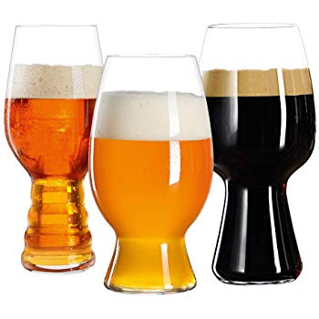

Slide 3

Target audience
Users who love beer and are willing to explore new beers in new locations
Suited for business and pleasure travelers
Travelers who want to choose a destination based on beer choices
Users must be adults

Slide 4
Problem the Application Solves
Not knowing what beers are available around the world and always ending up drinking similar brands, the application allows to search by category, style and brand on various locations
For business travelers with reduced time it tends to be hard to find dining options, this application will suggest nearby places by association to selected beers
In addition, for leisure travelers, the application will also show weather forecast to enjoy a perfect beer experience

Slide 5
Absolute mínimum functionality (MVP)
Choose either
Current location
Select specific target location
Get a location (trip destination) based on a feeling lucky search result for beers
Explore beer options: categories, styles and brands
Inform weather details in beer destinations
Inform about nearby dining options
Provide beer details to user, so he/she can get familiar with available options on selected location

